Slide 1

End User Computing

Slide 2
Amazon AppStream 2.0
Fully managed Application Streaming Service that allows to securely stream Desktop Applications from AWS Cloud to you users without acquiring, provisioning infrastructure
Stream a desktop application to web browsers (no need to connect to a VDI) & SaaS
AppStream is an application streaming service that grants users instant access to applications to use remotely (from anywhere) on Windows PCs, Chromebook and Macs.
3D CAD Design Software
https://aws.amazon.com/appstream2/customers/

Slide 3
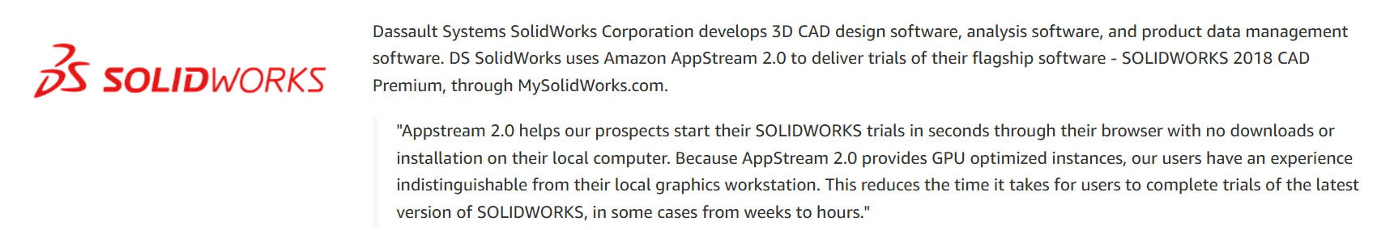
Case Study

Slide 4
Amazon WorkSpaces
Managed Desktop as a Service (DaaS) product / Managed VDI service to easily provision Windows or Linux desktops (Similar to Citrix)
No development on local but hence VDI .
Great to eliminate management of on-premise VDI (Virtual Desktop Infrastructure)
Fast and quickly scalable to thousands of users
Amazon WorkSpaces enables you to provision virtual, cloud-based Microsoft Windows, Amazon Linux, or Ubuntu Linux desktops for your users, known as WorkSpaces. WorkSpaces eliminates the need to procure and deploy hardware or install complex software. You can quickly add or remove users as your needs change.
No Data given to Developer for security purpose , hence Workspaces

Slide 5
Amazon WorkSpaces Web
Amazon WorkSpaces Web is an on-demand, fully managed, Linux-based service designed to facilitate secure browser access to internal websites and software-as-a-service (SaaS) applications.
Access the service from existing web browsers, without the administrative burden of infrastructure management, specialized client software, or virtual private network (VPN) solutions.

Slide 6
Frontend Web and Mobile

Slide 7
AWS Amplify
A set of tools and services that helps you develop and deploy scalable full stack web and mobile applications
Authentication, Storage, API (REST, GraphQL), CI/CD, PubSub, Analytics, AI/ML Predictions, Monitoring, Source Code from AWS, GitHub, etc…
Exam Question :-- deploy scalable full stack web and mobile applications -- AWS Amplify

Slide 8
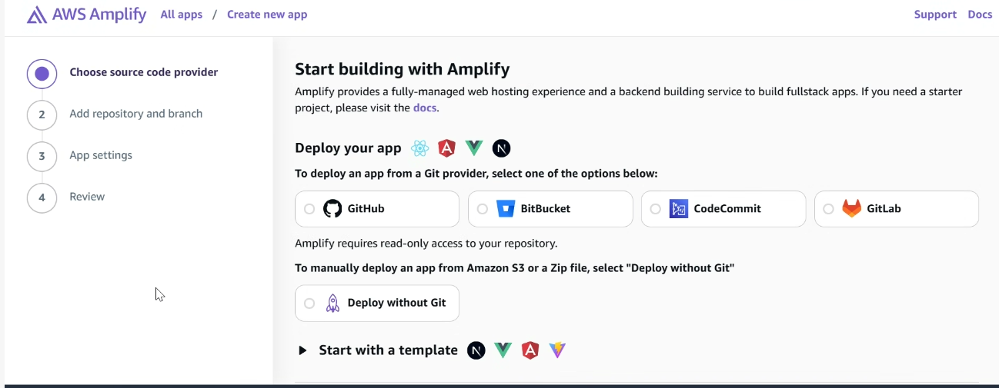
AWS Amplify

Slide 9
AWS AppSync
Store and sync data across mobile and web apps in real-time
Simplifies the process of developing applications by letting you create flexible , secure , extensible and real APIs
Integrations with DynamoDB / Lambda
Real-time subscriptions
GraphQL – Represents data in form of Graphs
QL== Query Language
Exam Question :-- GraphQL == AppSync

Slide 10
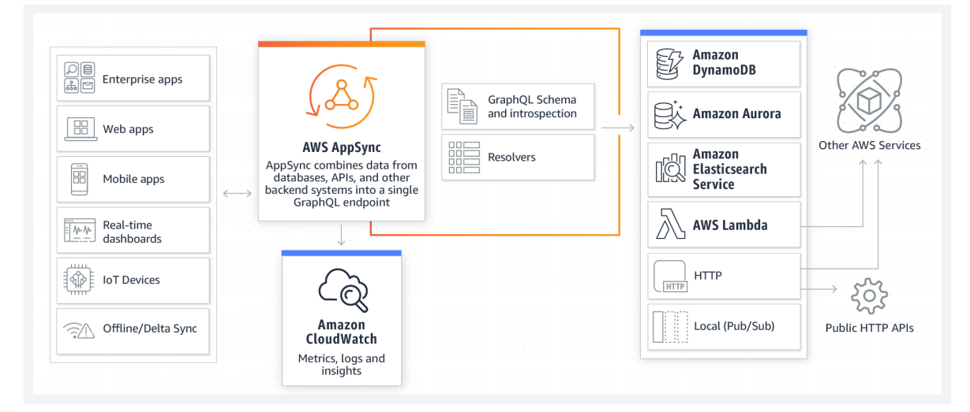
AWS AppSync

Slide 11
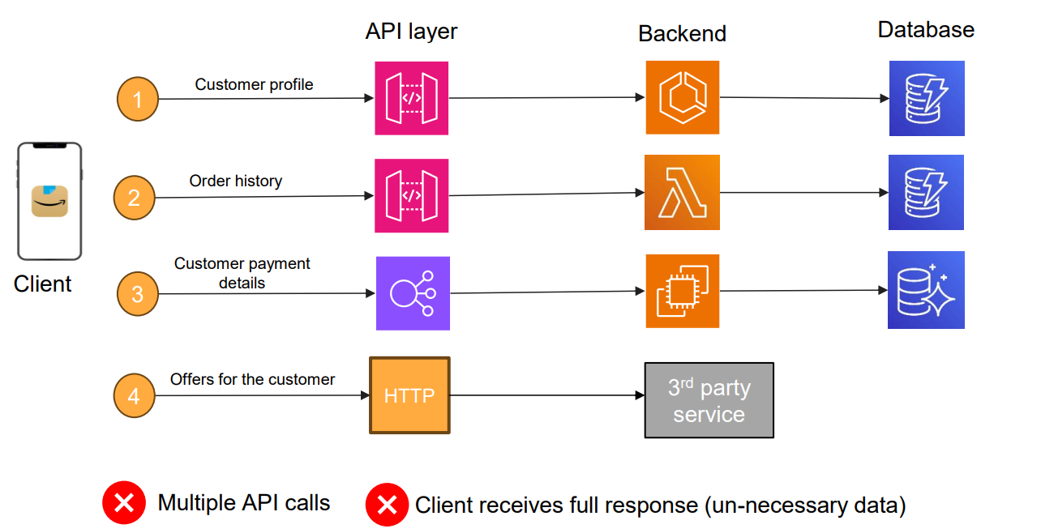
APIs for sample eCommerce application

Slide 12
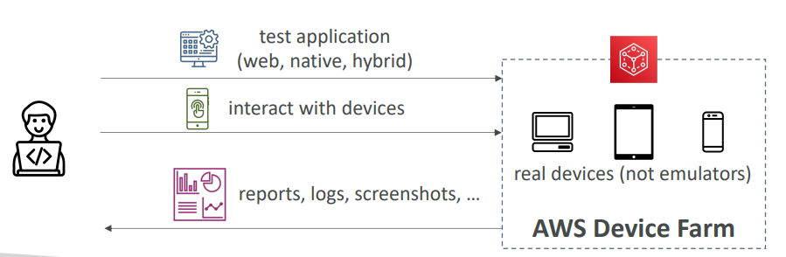
AWS Device Farm
Provides managed Web and Application testing
You have developed a Web or mobile application and you want to test it on every device , this is possible with Device farm.

Slide 13
Internet of Things (IoT)

Slide 14
AWS IoT Core
IoT stands for “Internet of Things” – the network of internet-connected devices that are able to collect and transfer data
Used for managing huge number of IoT devices (Temp Sensors , Wind Sensors , Water Sensors) and to Interact with AWS
AWS IoT Core allows you to easily connect IoT devices to the AWS Cloud. Serverless, secure & scalable to billions of devices and trillions of messages
In the logistics and supply chain industry, AWS IoT Core is used for asset tracking.
Smart Watches , Temp sensors , Auto door openers , Motion sensor

Slide 15
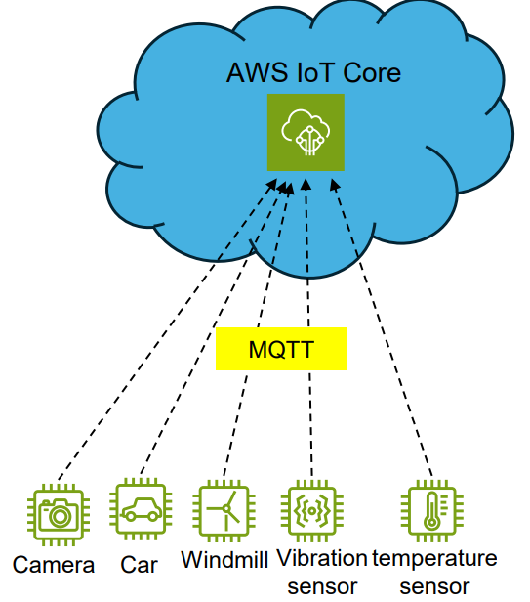
IoT Core
Use cases: Connected Cars, Connecting and monitoring of Industrial machines, Smart cities, Smart devices, Anomaly detection

Slide 16
AWS IoT Greengrass
Extends some AWS Services to the Edge
Instead of IoT Services running at the Edge and interacting with AWS Services over slow and unreliable connections , Greengrass allows some services including compute , messaging , Data Management , Sync and ML Capabilities.
AWS IoT Greengrass enables your devices to collect and analyze data closer to where that data is generated, react autonomously to local events, and communicate securely with other devices on the local network. Customers use AWS IoT Greengrass for their IoT applications on millions of devices in homes, factories, vehicles, and businesses.
Use cases: Safe homes, industrial predictive maintenance, autonomous vehicle etc.

Slide 17
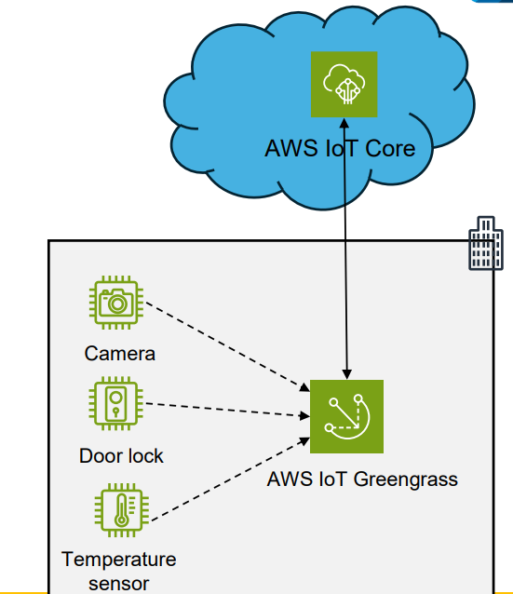
AWS IoT Greengrass

Slide 18
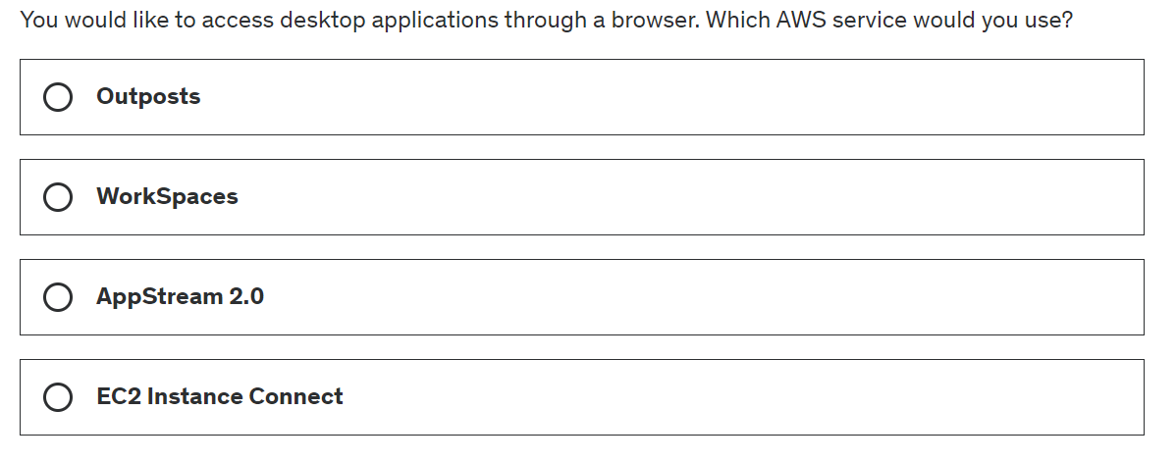
Question 1

Slide 19
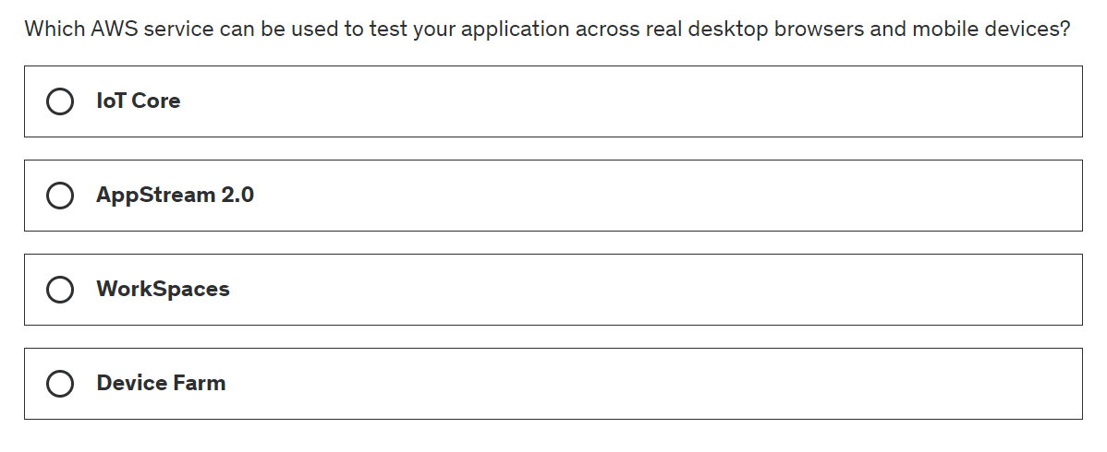
Question 2

Slide 20
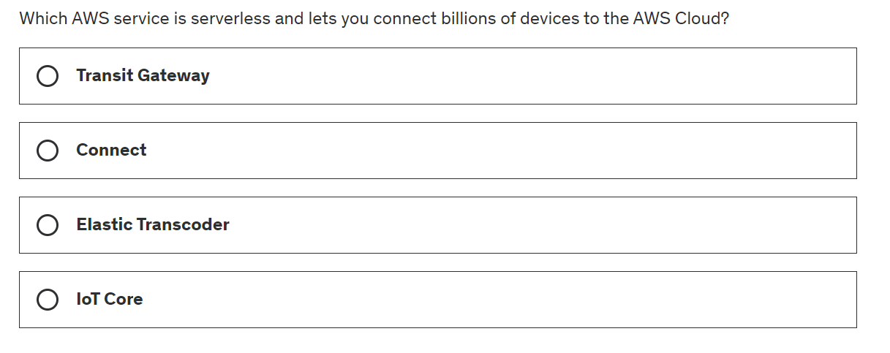
Question 3

Slide 21
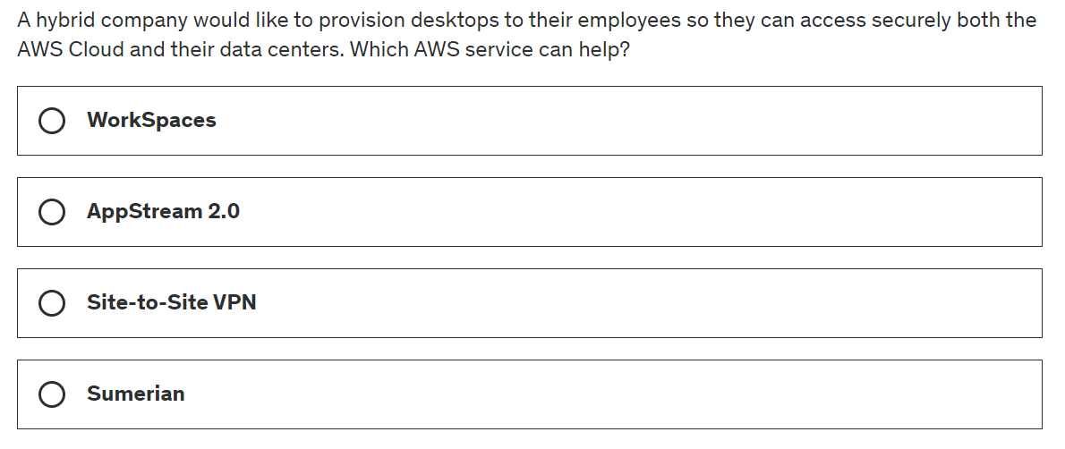
Question 4

